Slide 1


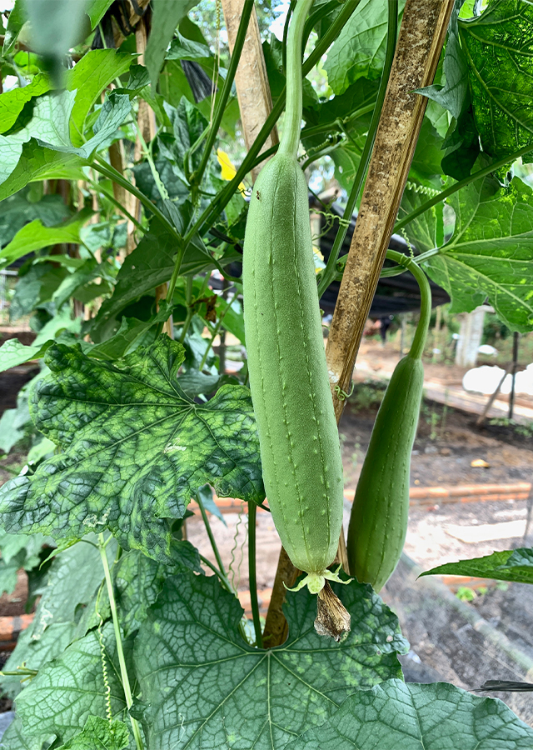
Khwaja Yunus Ali University
Department of Pharmacy
Research Title:
Antioxidant Activity of Aqueous Extract of
Pericarp of Luffa aegyptiaca (Sponge Gourd)
Submitted By
Fahmida Anam Mithila
ID: 0622030211091001
Semester: Summer 2024
Batch: 15th
Department of Pharmacy
Khwaja Yunus Ali University

Slide 2
Table of Contents
01
Background
05
Materials and Methods
02
Aims and Objectives
06
Result and Discussion
03
Plant Preview
07
Conclusion
04
Extract Preparation
08
References

Slide 3
Background
Known by many names as Egyptian cucumber or sponge gourd, Luffa aegyptiaca is used extensively in traditional medicine around the world, but especially in tropical and subtropical countries.
Its fruit, peel, and seeds have long been used by indigenous people to cure a variety of illnesses, including fever, gastrointestinal issues (including enteritis), inflammatory diseases, and localized edema. In addition to its medicinal uses, the plant is praised for its abundant nutritional profile, which includes vitamins, minerals, and bioactive substances including phenolic acids and flavonoids.
In this study we aim to evaluate antioxidant activity of aqueous extract of pericarp of Luffa aegyptiaca.

Slide 4
Aims and Objectives
The prime goal of this project work is to evaluate the following activities:
Assessment of antioxidant activity of aqueous extract of Luffa aegyptiaca pericarp by the following methods:
A. DPPH free radical scavenging assay
B. ABTS free radical scavenging assay
To compare its efficacy with standard antioxidant (ascorbic acid) in mentioned two methods

Slide 5
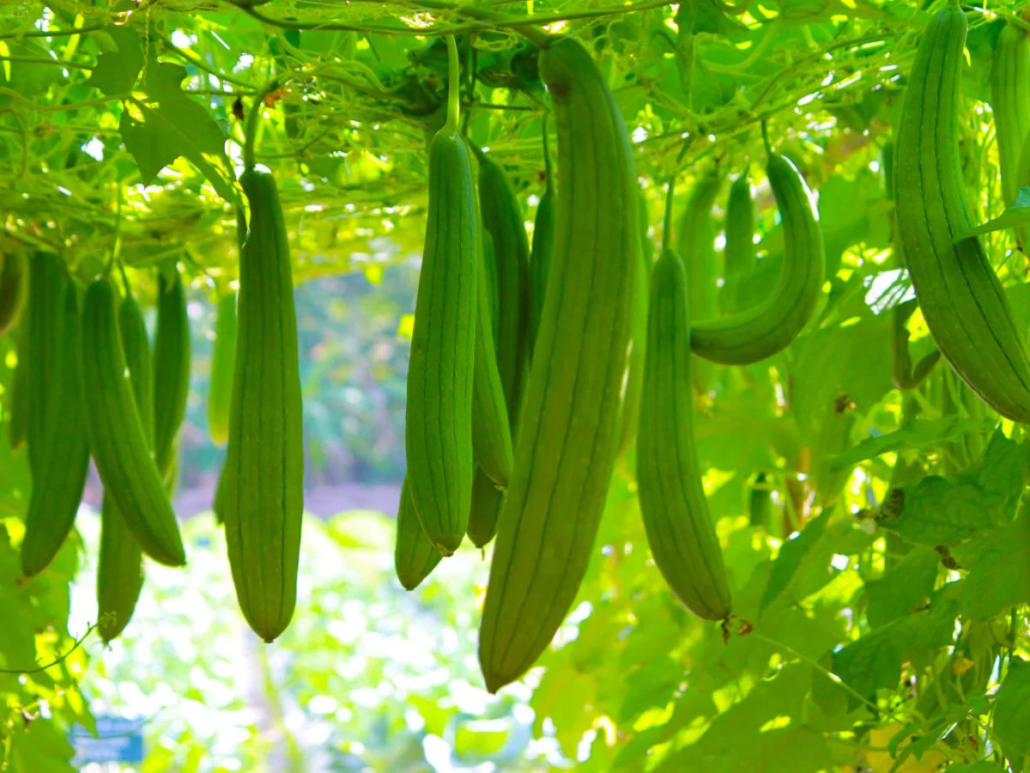
Plant Preview
Scientific Name: Luffa aegyptiaca
Common Names: Dishrag gourd, Rag gourd, Sponge gourd & Vegetable-sponge
Local Name: Dhundul
Geographical Distribution:
Native to South and Southeast Asia
Cultivated in China, India, Korea, Japan, Central America, Brazil

Slide 6
Continue
Taxonomical Classification
Kingdom: Plantae
Phylum: Tracheophyta
Class: Magnoliopsida
Order: Cucurbitales
Family: Cucurbitaceae
Genus: Luffa
Species: Luffa aegyptiaca

Slide 7
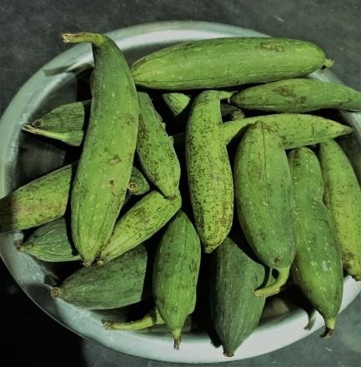
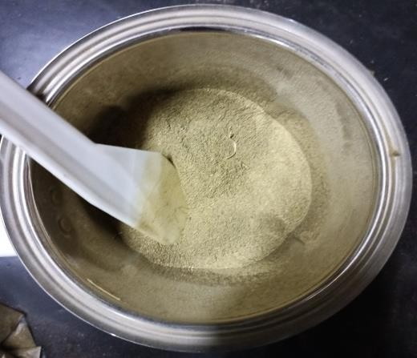
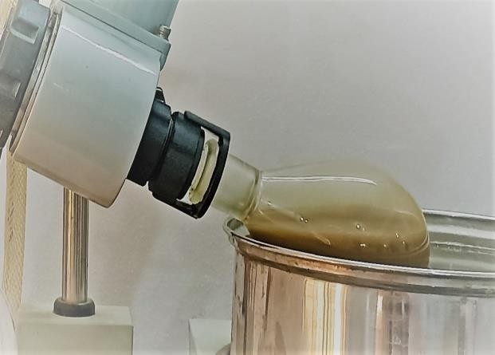
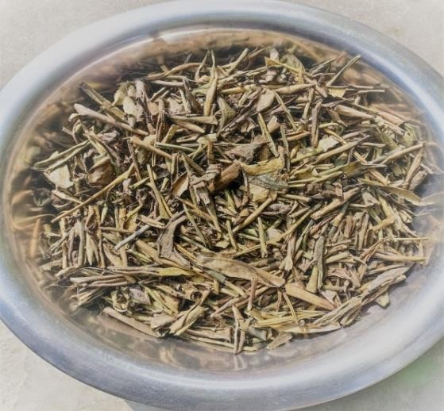
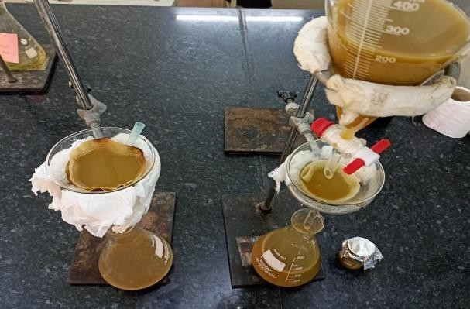
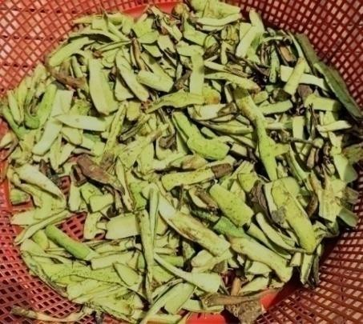
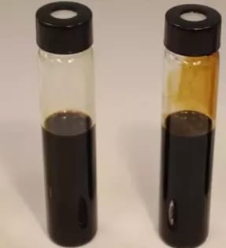
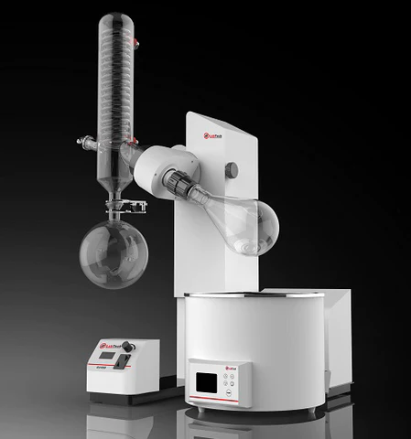
Extract Preparation
Step 1
Step 4
Step 6
Step 5
Evaporation with Rotary Evaporator
Step 3
Mixed Distilled Water
Plant’s Fruit Collection
By Grinding
Making powder of peels
Step 7
Drying
Step 2
Step 9
Filtration
Step 8
Separated Peels
Crude Extract
Solvent
Evaporation

Slide 8
Materials and Methods
Test Name: Antioxidant Activity Test
Method 1 : DPPH(2,2-diphenyl-1-picrylhydrazyl ) free radical scavenging assay
Materials of Method 1:
Appratus:
• Test tubes
• Beakers
• Micro – pipette
• Sonicator
• Pipette
• Conical Flask
• UV Spectrophotometer
• Electronic Balance
Reagents
• DPPH
• Methanol
• Ascorbic acid (as positive control)

Slide 9
Continue
Test Name: Antioxidant Activity Test
Method 2 : ABTS(2,2-azino-bis-3-ethylbenzothiazoline-6-sulphonic acid) free radical scavenging assay
Materials of Method 2:
Appratus:
• Test tubes
• Beakers
• Micro – pipette
• Sonicator
• Pipette
• Pipette filler
• Conical Flask
• UV Spectrophotometer
• Electronic Balance
Reagents
• ABTS
• Potassium persulfate (K₂S₂O₈)
• Ascorbic acid
• Ethanol
• Distilled Water
• Sample: Plant extract

Slide 10
Result and Discussion

Slide 11
Phytochemical Screening
Name of Groups | Result
Test for Alkaloids | +
Test for Carbohydrates | +
Test for Saponin | +
Test for Flavonoids | +
Test for Tannins | +
Test for Phenolic | +
Test for Terpenoids | +
Here,
(+)= Present
Result: From this test, we find that Alkaloids, Carbohydrates, Tannins, Saponin, Flavonoids, Terpenoids, and Phenolic are present in the Aqueous Extract of Pericarp of Luffa aegyptiaca (Sponge Gourd)

Slide 12
Antioxidant Activity Test

Slide 13
DPPH Free Radical Scavenging Activity
% RSA (Radical Scavenging Activity)
Figure : Graphical representation of % of DPPH radical scavenging
activity vs Concentration of Luffa aegyptiaca

Slide 14
The DPPH assay measures a substance’s ability to neutralize free radicals, with lower IC₅₀ values indicating superior antioxidant efficacy. The pericarp extract exhibited strong radical scavenging activity, achieving an IC₅₀ of 485.843 ± 88.902 µg/mL. This suggests moderate antioxidant potential, requiring higher concentrations to neutralize 50% of free radicals compared to synthetic standards. Ascorbic acid (reference standard) demonstrated significantly higher efficacy, with an IC₅₀ of 9.287 ± 2.495 µg/mL. This stark difference highlights the extract’s relative limitations in scavenging free radicals at lower concentrations.
Table 1 : IC₅₀ value of Luffa aegyptiaca pericarp extract & standard for DPPH Assay
Methods | Extracts | Standard
 | L. aegyptiaca | Ascorbic Acid
DPPH/ IC₅₀ (µg/mL) | 485.843±88.902 µg/mL | 9.287±2.495µg/mL

Slide 15
ABTS Free Radical Scavenging Activity
Figure : Graphical representation of % of ABTS radical scavenging
activity vs Concentration of Luffa aegyptiaca

Slide 16
The ABTS assay evaluates comprehensive antioxidant capacity by measuring the inhibition of cationic radical formation. The pericarp extract showed notable free radical neutralization, with an IC₅₀ of 200.964 ± 45.202 µg/mL. This indicates a stronger performance in the ABTS test compared to the DPPH assay, likely due to differences in reaction mechanisms and radical stability. Ascorbic acid again outperformed the extract, registering an IC₅₀ of 10.139 ± 3.195µg/mL. The extract’s higher IC₅₀ underscores its reduced efficiency in stabilizing complex radical systems compared to synthetic antioxidants.
Table 2 : IC₅₀ value of Luffa aegyptiaca pericarp extract & standard for ABTS Assay
Methods | Extracts | Standard
 | L. aegyptiaca | Ascorbic Acid
ABTS/ IC₅₀ (µg/mL) | 200.964 ± 45.202 µg/mL | 10.139 ±3.195 µg/mL

Slide 17
Conclusion
Findings indicate that Luffa aegyptiaca pericarp extract possesses promising antioxidant properties under the tested conditions. Further exploration is warranted to uncover additional bioactive potentials and validate its applicability in pharmaceutical or nutraceutical contexts.

Slide 18
References
Du, Q., Zhu, Z., & Wang, X. (2006). Antioxidant and Antimicrobial Activities of Luffa aegyptiaca Extracts. Journal of Ethnopharmacology.
Panicker, S. P., et al. (2020). The Pharmacological Potential of Luffa aegyptiaca in Traditional Medicine and Modern Therapeutics. Molecular Biology Reports.
Davis, J. M., & De Courley, C. D. (1994). "Luffa Sponge Gourd Production Practices for Temperate Climates." HortTechnology, 4(3), 253–257.
Seshadri, V., & More, T. A. (2009). "Origin and Diversity of Sponge Gourd." Journal of Horticultural Science, 11(2), 102–109.
Nnam NM & Okorie IJ (2024). "Hypoglycemic and lipid-lowering effects of L. aegyptiaca decoctions." PriMera Science Medicine Public Health.
Rahman, Md. M., et al. (2024). "Phytochemical Profiling and Bioactivity of Luffa aegyptiaca." International Journal of Scientific Research.
Porterfield, W. M. (1955). "Loofah Sponge Gourd: Its Cultivation and Uses." Economic Botany, 9(1), 3–19.
Rahul, R., et al. (2024). "Morphological, Reproductive and Biochemical Diversity in Luffa aegyptiaca Cultivars." International Journal of Horticultural Science and Technology, 11(2), 1021–1039.
Easy Ayurveda (2016). "Sponge Gourd: Benefits, Usage, Research, Remedies, Side Effects."
Oboh, I. O., & Aluyor, E. O. (2009). "Sponge Gourd: Uses and Applications." International Journal of Plant Sciences, 34(21), 827–840.
Joshi, B., et al. (2004). "Genetic Diversity in Luffa Species." Plant Genetic Resources Newsletter, 137(3), 45–52.
Chabert-Llompart, J. (2020). "Invasive Potential of Luffa Species." Journal of Tropical Agriculture, 58(1), 12–18.

Slide 19
Thank You

